Slide 1
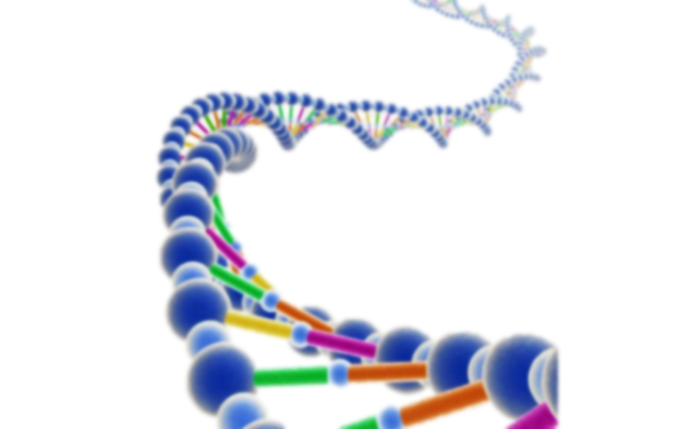
Genome Analyzer
bioserver

Slide 2

Team Members
Salma Ahmed Abdelrahman
Reham Tarek
Samaa Khaled
Alaa fathy
Hager Khaled

Slide 3
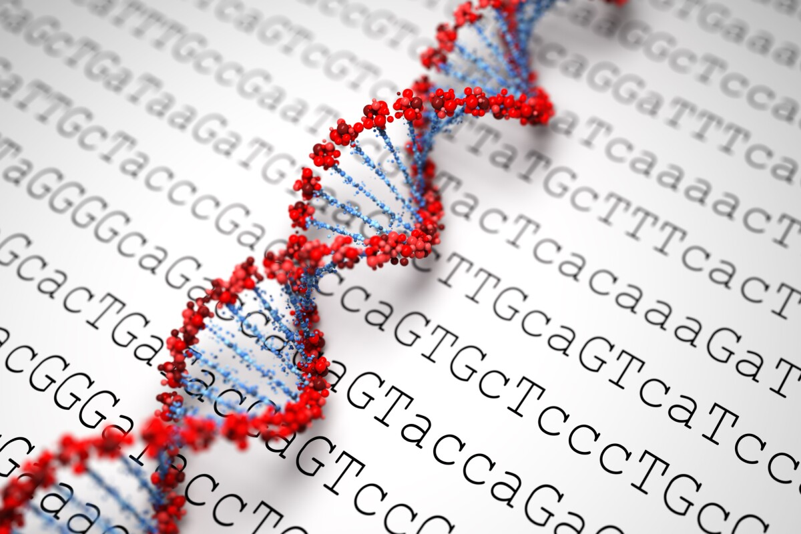
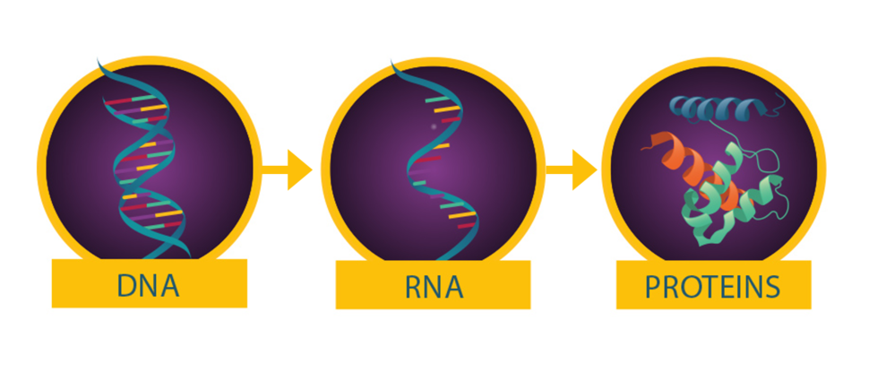
Project Description
What is the genome ?
Analysis
as: GC content
Operations
as: Central dogma

Slide 4
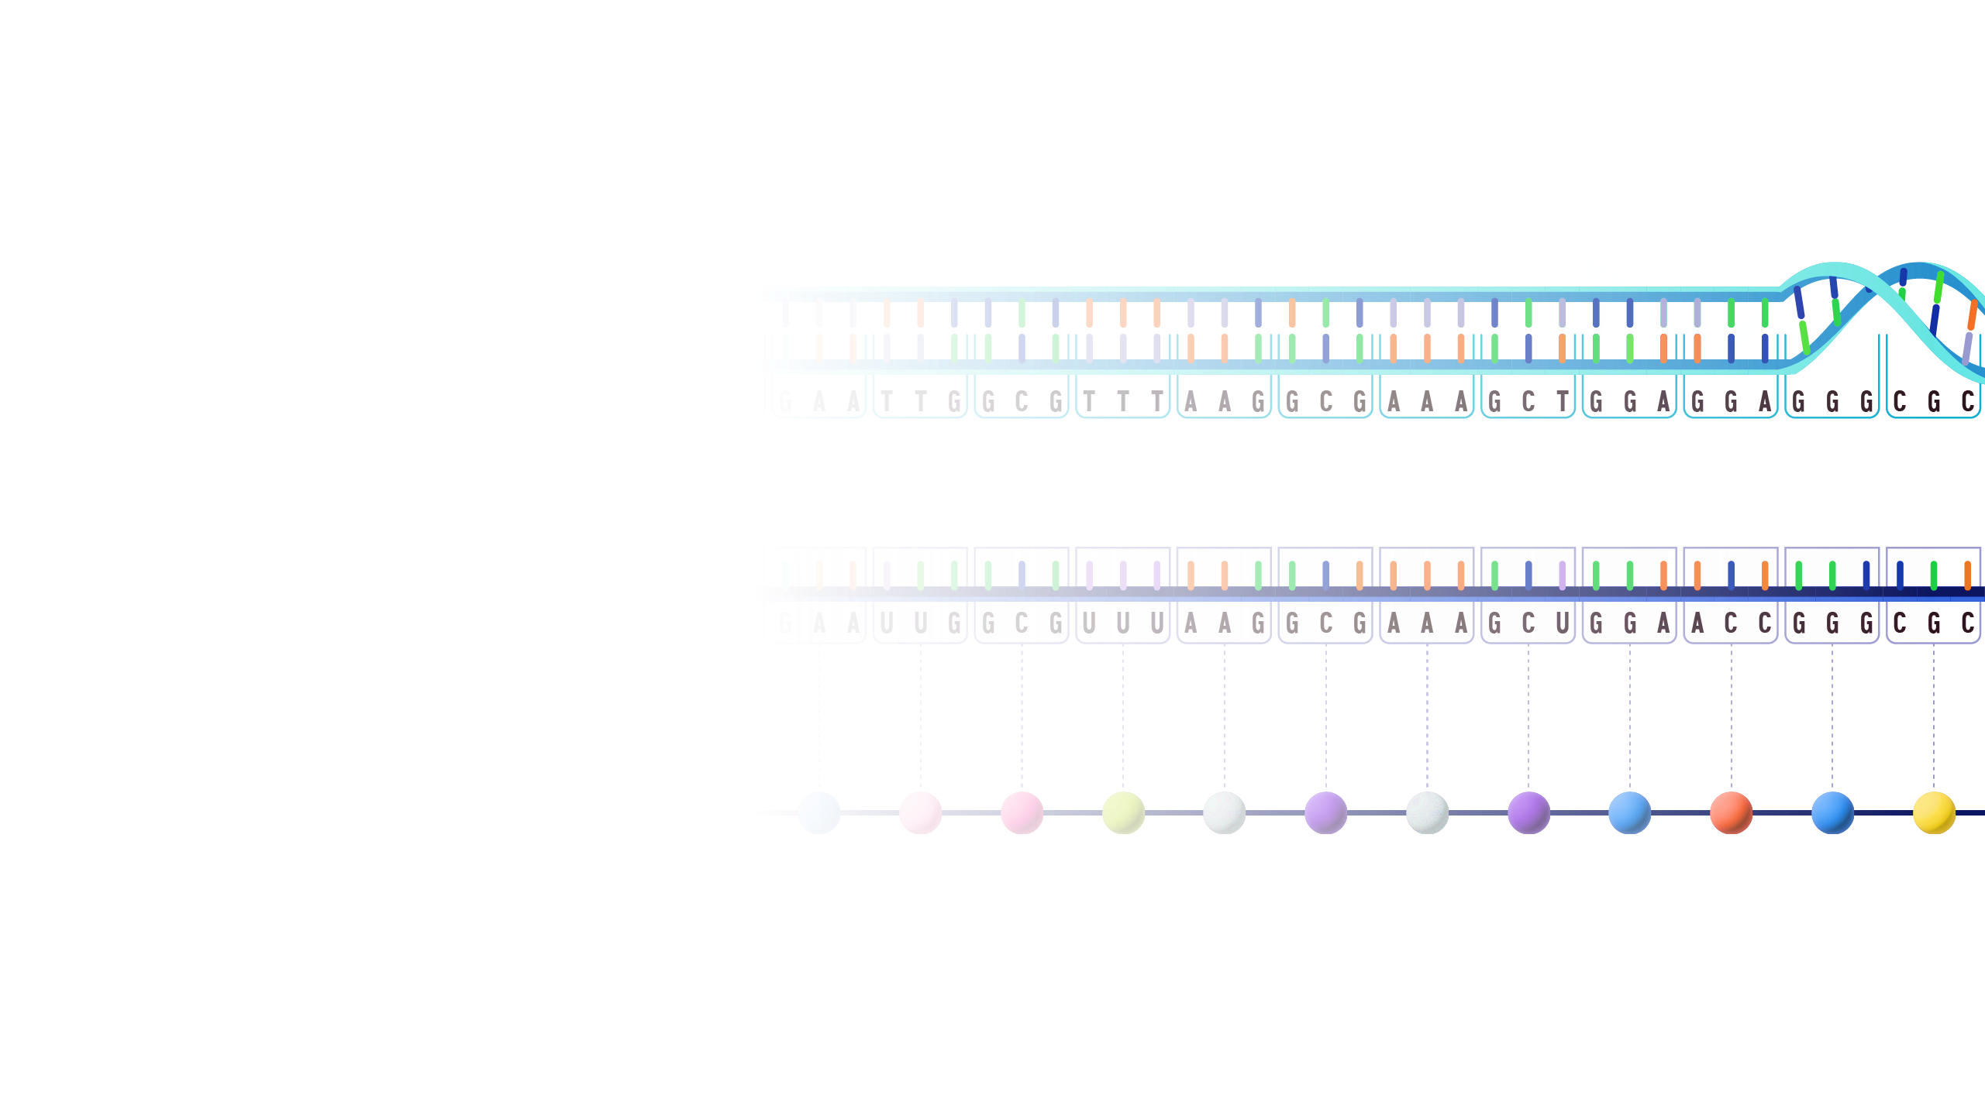
Functions
GC function
Complement function
Reverse function
Reverse complement function
Temperature function
Transcribe function
Translate function

Slide 5
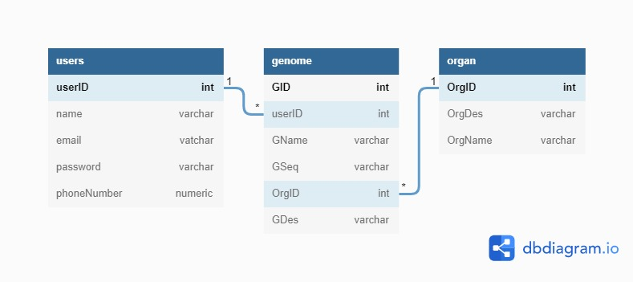
Database Schema

Slide 6
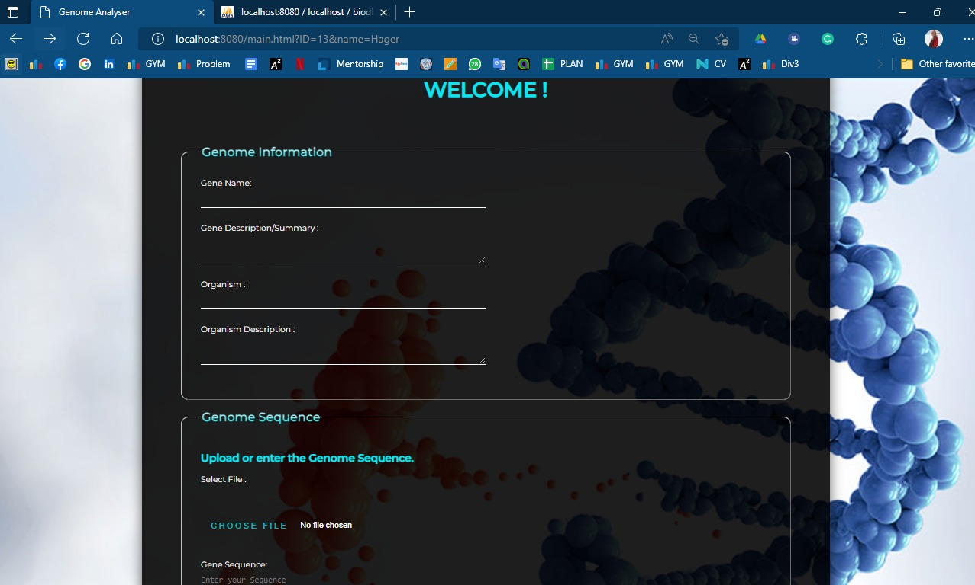
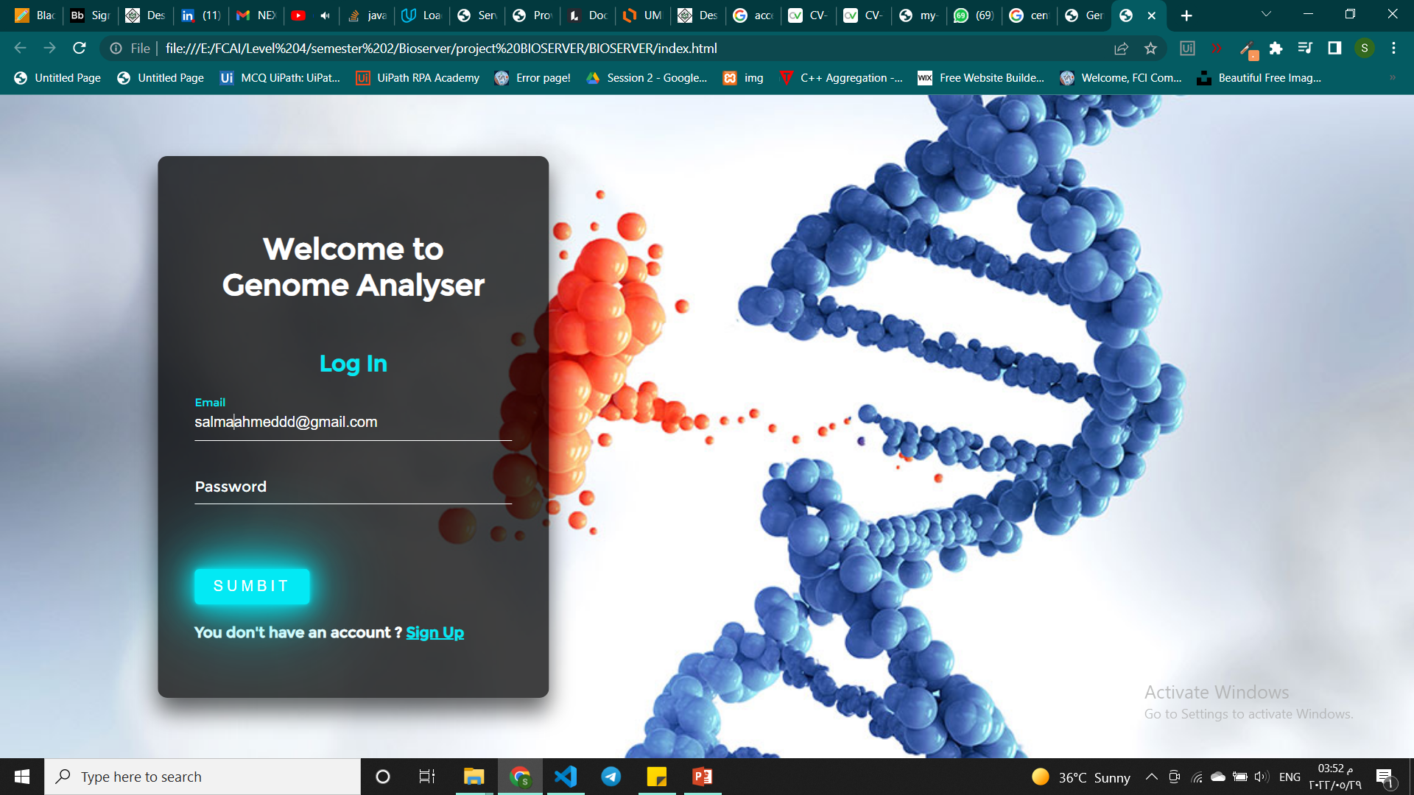
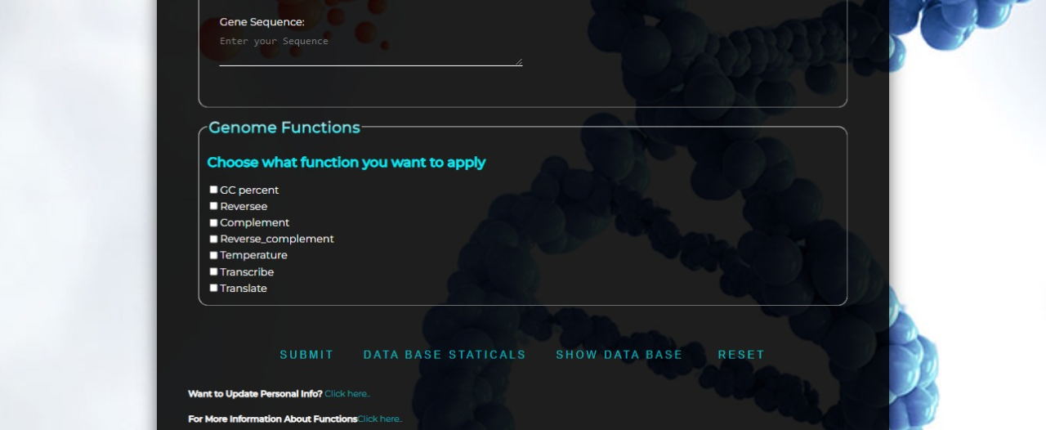

Slide 7
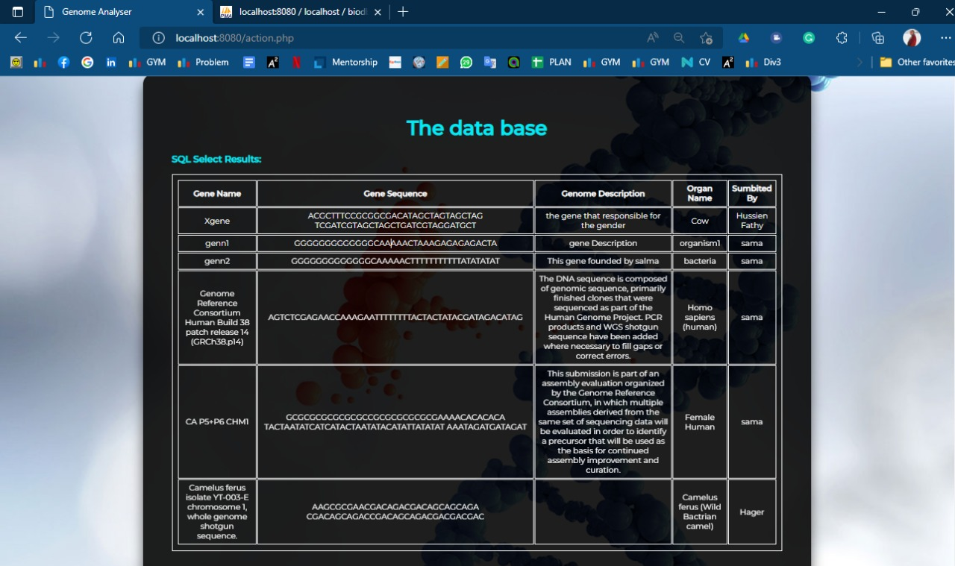
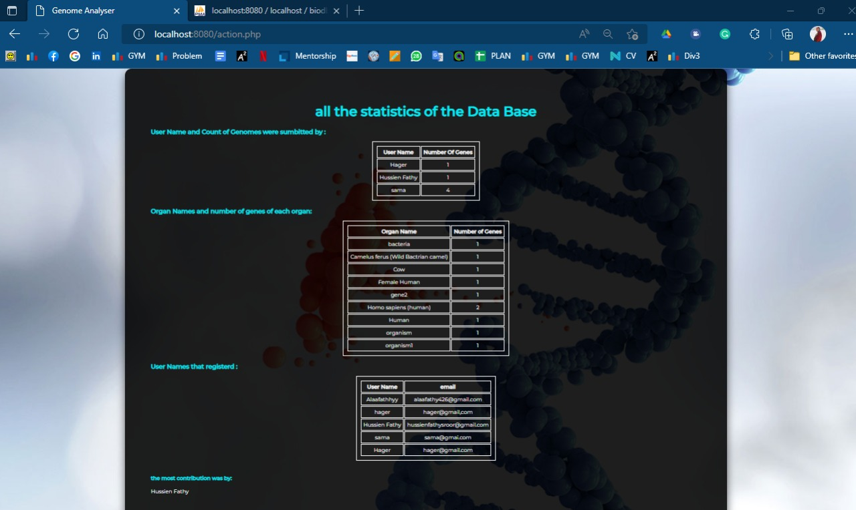

Slide 8


